Slide 1

-
Forecasting Market Trend Project Report
Presenter: Haruna Jallow
Internship : Mentorness Internship Program, 2024

Slide 2
Setup and Initialization
I imported all the libraries and utilities I needed for the project such as matplotlib, numpy, seaborn, statsmodels,prophet for the algorithms
I also import the datasets ie the CSV files that was given for the project containing (10227, 10)

Slide 3
Data Preprocessing
Data preprocessing is a data mining technique that transforms raw data into an understandable format. This process has four main stages – data cleaning, data integration, data transformation, and data reduction
In the data cleaning process checked for the missing values, trend, seasonality, correlation and noise in the data.
I label encoded 'city', 'market', 'state’ columns

Slide 4
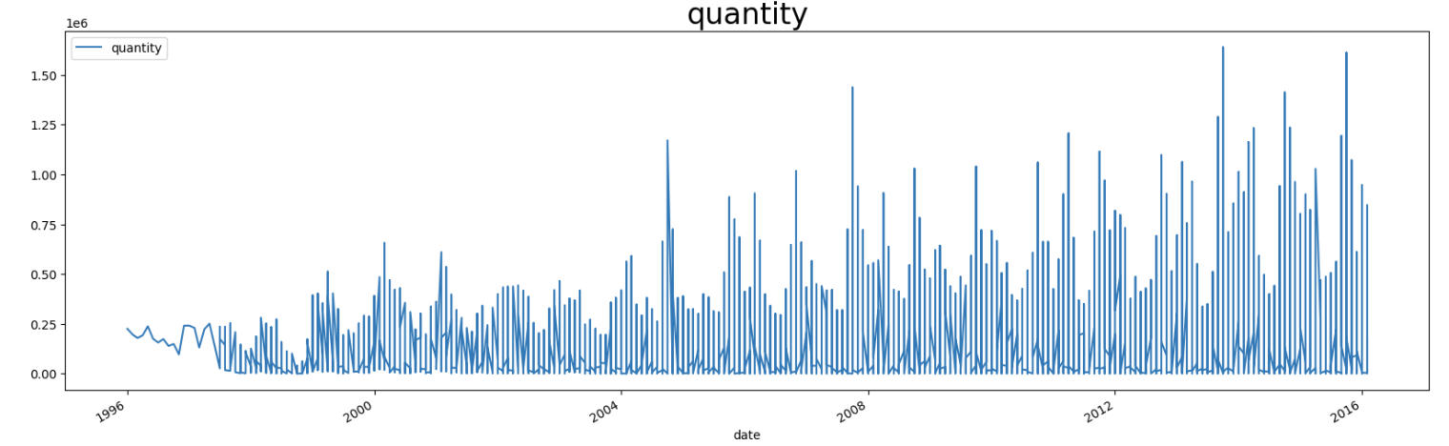
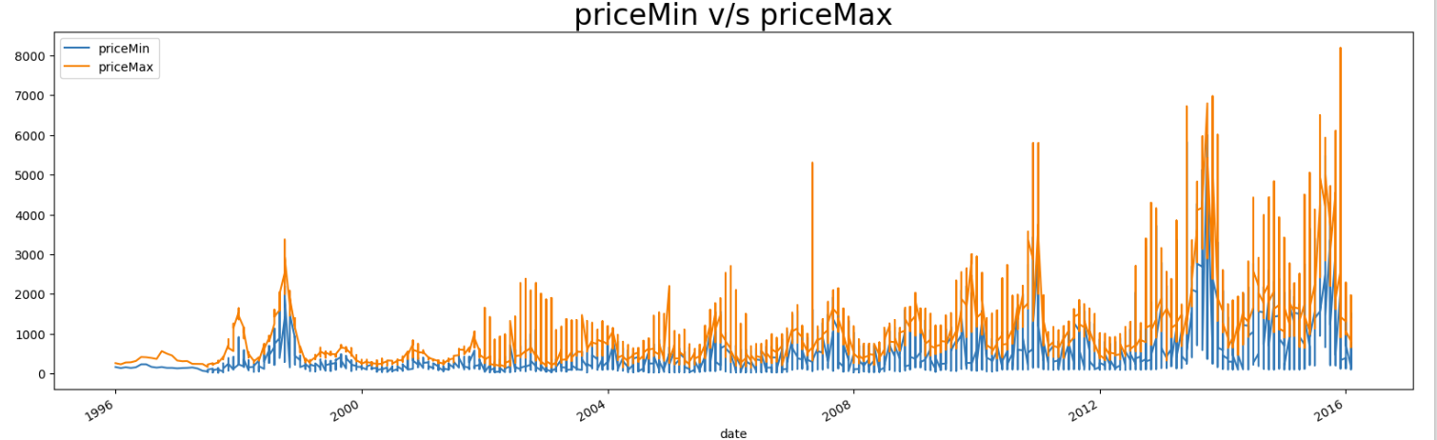
Exploratory Data Analysis (EDA)
The quantity of the commodity traded or available showed an increase trend growth during the period. And most frequently occurring price of the commodity during the month is from 2012 to 2016.

Slide 5
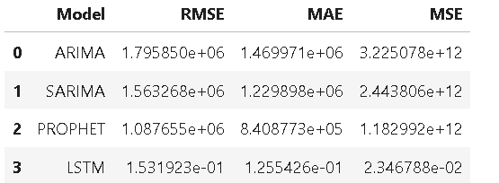
Forecasting Models
The following algorithms are chosen to fit to the datasets.
ARIMA
SARIMA
Prophet
LSTM

Slide 6
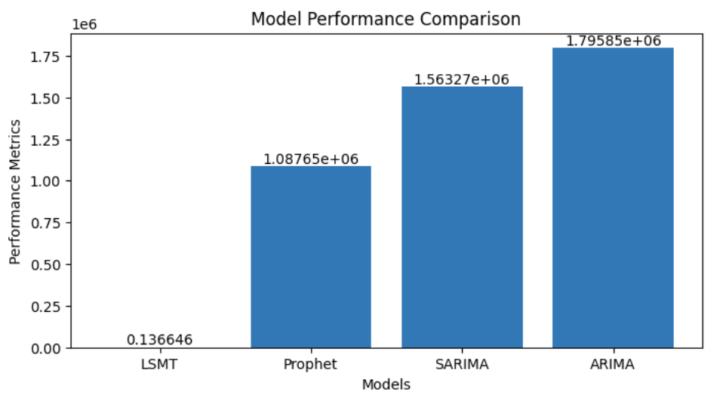

Cont.
Based on the RMSE and MAE, PROPHET appears to be the best-performing model. It has the lowest values for both metrics, indicating it makes more accurate predictions with smaller errors compared to ARIMA, SARIMA, and LSTMRandom Forest
While the LSTM model shows very low values for RMSE and MAE, these are likely normalized values, as deep learning models typically output predictions on a normalized scale. Thus, its performance should be compared in the context of the specific dataset and scaling used.
Based on RMSE and MAE, the PROPHET model is recommended for this time series forecasting task.

Slide 7

Analysis of Results
1st Most Stable
LSTM
2nd Most Stable
Prophet
3rd Most Stable
SARIMA
least reliable
ARIMA

Slide 8
THANKS!
Q&A

